Slide 1

ADVANCE OOP
DATABASE

Slide 2
What is Data?
Raw facts that has some meaning in user environment
Data could be of type:
Structured : Numerical, text,
Unstructured : graphic, maps, images, sound and video segments

Slide 3
DATABASE
Database is a centralized, and organized collection of some logically related organizational data
In database, data is organized using some Data Model
Notes:
Logically related data means that the data should be relevant in some context. Example: If we are going to make a database for a customer then the database may include customer name, contact number, age, past orders, address, email id, etc. All these information are in the context of the customer

Slide 4
Data Model
Data Model is collection of concepts and theories used to organize data
Common data models are
Network
Relational
Object Oriented
Object Relational etc.
In short, we use some data model to organize data or build database
Notes:
A network database is a database model where numerous records or files can link to multiple owner files and vice versa.

Slide 5
Relational Data Base Model
The relational model represents how data is stored in Relational Databases. A relational database consists of a collection of tables, each of which is assigned a unique name.
Table is main ingredient in RDBMS
A database may consists of Many tables
Every table has unique names in Database
Notes:
RDBMS Stores data in the form of tables or we can say collection of tables.
A table is also called relation
Rows --------->tuple Columns :column arranges data vertically from top to bottom (attributes or fields)

Slide 6
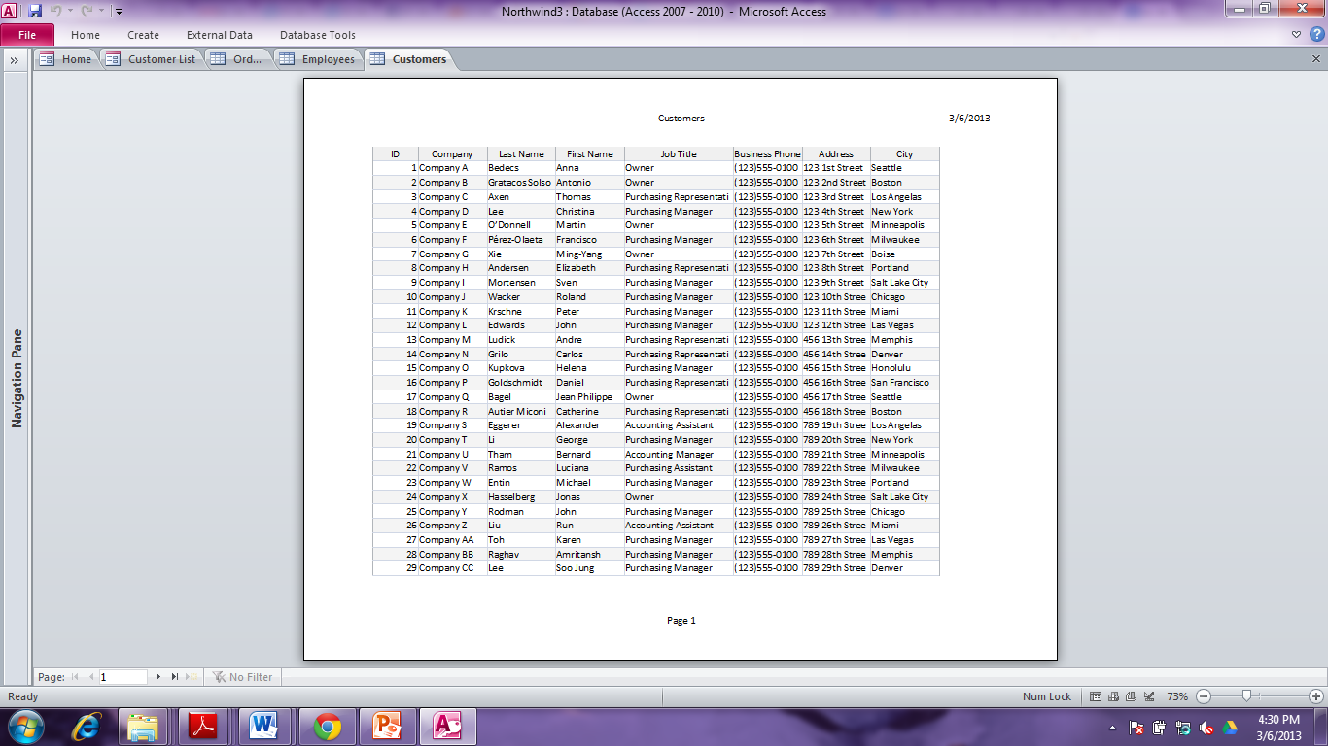
Database
Rows / Records are unnamed
Columns/Fields are named First rows labels names of column

Slide 7
Database
Every column has unique name at table level
Rows are known as record
Each data of Column Belong to same domain (Data Type)
Every table in database has a primary key

Slide 8
Primary Key
An attribute(Column) or combination of attributes that uniquely identify each row in a relation
In short notation we can express this relation as:
EMPLOYEE(Emp_ID,Name,Dept_Name,Salary)

Slide 9
Create Statement
Create Command
The create command is use to create new database and new tables.
The CREATE DATABASE command is used is to create a new SQL database.
The following SQL creates a database called "testDB":
CREATE DATABASE testDB;

Slide 10
Create Statement
The following example creates a table called "Persons" that contains five columns: PersonID, LastName, FirstName, Address, and City:
CREATE TABLE Persons(
PersonID int, LastName varchar(255), FirstName varchar(255), Address varchar(255), City varchar(255) );

Slide 11
Insert Statement
To insert values into a table in MySQL, you can use the INSERT INTO statement. Here's the basic syntax for inserting values into a table:
INSERT INTO table_name (column1, column2, column3, ...)
VALUES (value1, value2, value3, ...);
Replace table_name with the name of the table into which you want to insert data.
Inside the parentheses after table_name, specify the names of the columns into which you want to insert data. If you're inserting data into all columns, you can omit this part.
After the VALUES keyword, provide the actual values you want to insert into the specified columns. The values should be enclosed in parentheses and separated by commas

Slide 12
Insert Statement
INSERT INTO employees (first_name, last_name, email, hire_date, salary)
VALUES ('John', 'Doe', 'john.doe@example.com', '2023-09-27', 60000.00);

Slide 13
Select Statement
To view the values inserted into a table in MySQL, you can use SQL SELECT statements
SELECT * FROM employees;
You can also specify particular columns if you're only interested in certain information. For example, if you want to see only the first and last names of employees, you can do:
SELECT first_name, last_name FROM employees;

Slide 14
Update Statement
To update data in database , you can use the SQL UPDATE statement. Here's the basic syntax for an UPDATE statement:
UPDATE table_name
SET column1 = value1, column2 = value2, ...
WHERE condition;

Slide 15
Update Statement
Breakdown of the syntax is as follows:
UPDATE table_name: Specifies the name of the table you want to update.
SET column1 = value1, column2 = value2, ...: Specifies the columns you want to update and the new values you want to set for them.
WHERE condition: An optional clause that allows you to specify a condition that determines which rows should be updated. If you omit the WHERE clause, all rows in the table will be updated.
Notes:
If where not used and have multiple rows with same columns all the rows will be affected

Slide 16
Delete Statement
To delete data from a table you can use the DELETE statement. The basic syntax for the DELETE statement is as follows:
DELETE FROM table_name
WHERE condition;
You can also use “DROP TABLE” to delete/drop the whole table

